Slide 1
AN EFFICIENT SNOW PLOW MODEL TO DEDUCE PLASMA FOCUS MACROSCALE PARAMETERS
Brian L. Bures and Mahadevan Krishnan
Alameda Applied Sciences Corporation
3077 Teagarden Street, San Leandro, CA 94577, USA

Slide 2
Abstract
As early as 1971 two dimensional models of plasma focus behavior were implemented¹. Lee² developed a one dimensional snow plow model that uses four free parameters (mass and current fractions in both axial and radial flows) to fit to measured data. This model has proved to be a useful tool for DPF design, but is not amenable to rapid analysis of a high data rate DPF. In the spirit of Lee’s model, a multiphase snow plow model was implemented to determine the properties of the axial rundown and radial implosion of a plasma focus. The model is computationally efficient so it is useful for machines that fire at >1Hz repetition rate to enable near real time data reduction.
The model inputs are the measured current, voltage and geometry of the electrodes. The model determines the axial plasma velocity, radial implosion velocity, the minimum current carrying radius (via the dynamical inductance) and the pinch voltage. The model is used to examine results from a 250 kA plasma focus.
1. D. E. Potter “Numerical Studies of the Plasma Focus” The Physics of Fluids vol 14 pp 1911-1924.
2. Plasma Focus (Radiatative) Computation Model and Code. S. Lee Website, HTTP://WWW.PLASMAFOCUS.NET/IPFS/MODELPACKAGE/FILE1RADPF.HTM

Slide 3
Objective
Use terminal measurements to extract the global plasma focus dynamics
  Axial and radial velocity
  Pinch radius?
Evaluate the limitations of this approach.
Try to link terminal measurements with radiation yield, radiation duration and other user critical properties.
Determine additional diagnostics to provide the necessary information to advance the analysis for comparison with models

Slide 4
Inputs
Measure dI/dt and voltage near the load.
Impedance in front of the probe location must be known.
Geometric information about electrodes.
Properties of the gas including molecular weight and pressure

Slide 5
Electrode geometry
z_{i}
r_{c}
r_{I}
r_{a}
C_{L}
z_{a}

Slide 6
Analysis method (The easy part)
Solve voltage analysis to get inductance
Assume R(t) is small or negligible (<<1 mΩ)
Use second order backward difference approximation to solve for L at each time step
Getting L is the easy part.

Slide 7
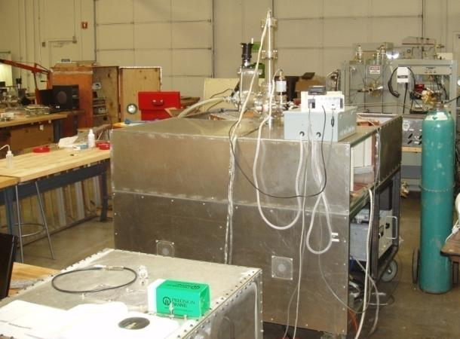
DPF-3
DPF-3 is a calibration tool for soft X-ray and neutron detectors for large burst situations.
System designed to produce 0.5J/pulse Ar SXR (3.1keV) and >10⁸ n/pulse operating at <0.2Hz.
Typical currents are 200-400kA in 1.2µs rise time pulse
Anode: 30 mm diameter, 60 mm length
Cathode: 60 mm diameter, 3mm diameter rods x 16
Insulator: Alumina 25 mm long with 43 mm OD

Slide 8
Observations of DPF-3 D₂ shot
Pinch is clearly visible as step in the inductance near 1500 ns.
Smooth increase in inductance from start to end.
No evidence of re-striking by lowering inductance

Slide 9
Observations Cont.
Red circle is the location of the maximum current
Black circle is the minimum in dI/dt
  Only a fraction of the inductance step takes place at minimum in dI/dt

Slide 10
Observations Cont.
dL/dt has distinct regions
Region 1: Breakdown
Region 2: Acceleration
Region 3: Constant Speed
Region 4: Radial Implosion
1
2
3
4

Slide 11
Identify regions
Identify regions using dL/dt
I²t space is much easier to identify region changes

Slide 12
Axial Phase Fit
Fit L(t) with 1D snow plot as shown below
The parameter α corrects for 2D effects
The fit parameters are α=3.15 H/C with an offset inductance of 15.2 nH.
Speed at peak current is 87 km/s
I_{max}

Slide 13
Model vs. Experiment
Breakdown
Stable flow
Radial implosion
Model
C_{L}
Experiment

Slide 14
Axial Corrections
An axial location correction factor (f_{L}) can be calculated based upon the estimated location of the radial start and the length of the anode
A mass correction (f_{m}) factor can be calculated from α using the geometric information of the electrode and the gas properties
f_{L}=0.97±0.04
f_{m}=0.11±0.012

Slide 15
Radial Region
By subtracting 1D snow plow fit from L(t), the radial contribution is clearly visible
Calculate z from 1D snow plow but it needs a correction
  z(t) in 1D snow plow is a mean
  The start of the radial region can be identified.
  Use ratio between model and known to correct for the actual length of leading edge
Maximum implosion speed was 200 km/s

Slide 16
Radial Analysis
Using 1D snow plow z(t) with constant correction factor to calculate radial contribution
Use anode radius as outer diameter and implosion radius as inner diameter
Where f_{L} is the inductance correction factor interpreted as the leading edge of z(t) being ahead of the mean location defined by the snow plow model
Radial implosion speed peaks at 200 km/s

Slide 17
Neutron yield
Should correlate with pinch voltage and minimum radius
Both have wide spread loose correlations
B. L. Bures, M. Krishnan and R. E. Madden IEEE Trans. Plasma Sci. Vol. 39 No 12 pp 3351-3357 (2011)

Slide 18
V_{pinch} and r_{min}
The pinch voltage and radius should be related as well
Again, a loose correlation exists

Slide 19
Conclusions
1D snow plow seems to capture the axial phase dynamics well.
Some improvements are required to the model to eliminate cases with inductance fractions greater than 1.

